Slide 1
We will begin soon!
Thank you for your patience.

Slide 2
Western Libraries Subscriptions Forum
February 13, 2025
Notes:
**Begin recording**
Welcome to our Western Libraries Subscriptions Forum
My name is Madeline Kelly (she/her) -- I'm the Director of Collections for the Western Libraries and currently serving as Interim Dean
I'd also like to introduce my colleague Mary Wegmann (she/her) -- Mary is serving as our Acting Director of Collections and will be monitoring the Q&A this afternoon

Slide 3
Housekeeping
Notes:
I'd like to begin with some housekeeping
First, this session is being recorded and we plan to post the recording with closed captions and the slides themselves to the library website next week
During the presentation, we invite you to submit questions via the Q&A feature; we may answer some of the questions in writing as we move through the presentation; others we may save and answer verbally at the end
Any questions that we don't answer today will be addressed on the library website via our subscription FAQ, which we plan to update after today's forum

Slide 4
Today's agenda
Overview of library collections and costs
The current subscriptions situation
Subscription review process and next steps
Short- and long-term alternatives for access
Plans for follow-up
Q&A
Notes:
The presentation this afternoon will provide an overview of library collections and their associated costs,
the current subscriptions situation and the need for cancellations,
the subscription review process (including what you can expect over the next several weeks),
strategies for accessing materials in the short-term and strategies for improving our prospects long-term
options for following up after today's forum
And then, finally, we'll have a chunk of time for Q&A at the end
We do need to wrap up at 5:15, but hopefully we can cover a lot of ground before then

Slide 5
What are library collections?
the known & the less-well-known
backend systems
copyright fees
journals
(print and online)
media
(streaming and physical)
maps
books
(print and online)
aggregator databases
(full-text and indexing)
support for Open Access
ILL fees
course reserves
Notes:
We're here to talk specifically about subscriptions, but before we do that, I wanted to provide a slightly broader context
The Western Libraries Resource Access Budget—our collections budget, the budget we’re talking about today—covers a variety of types of things
For starters, our collections include—of course—books and journals (both print and electronic), purchased singly or as part of large packages
In addition to that, our collections include a large number of aggregator databases—things like EBSCO or ProQuest or PsycINFO or Web of Science—and a variety of media, both streaming and physical
The collection includes specialty formats, like maps; special-use collections like course reserves for classes; and Open Access items
Finally, I should mention that collections rely on significant backend infrastructure, including a variety of specialized systems, costs and processes for interlibrary loan and Summit, and costs and processes for copyright payments and other access components
This should give you a sense of the breadth of library collections and the breadth of what is supported by our collections budget

Slide 6
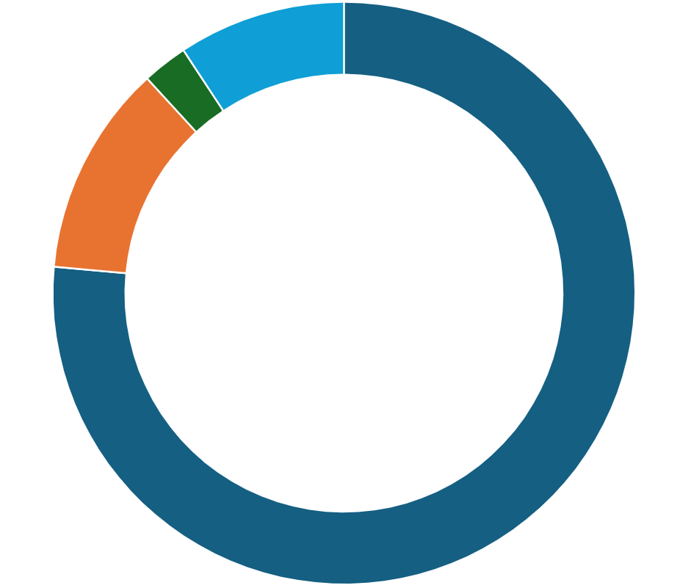
What do library collections cost?
Subscriptions mostly electronic; managed through sub review; new subscription request form
One-time purchases books, video; mixed formats; managed through regular review; purchase request forms
Access fees
Systems
$2.6M
Notes:
Given the breadth and complexity of library collections, what does all of this cost?
At Western, our full collections budget, including those backend systems costs, is approximately $2.6 million dollars and is divided roughly as follows:
About three-quarters of the funds go to supporting subscriptions. Most of these subscriptions are electronic (with the exception of a few print journals), they’re managed through the subscription review process, and can be requested using our new subscription request form
The remaining quarter of our collections budget is divided among one-time purchases, access fees, and systems
One-time purchases include books, videos, and other mixed formats (like maps); these items are managed through a variety of other maintenance and review processes outside of the subscription review; these items can be requested through their own purchase request forms
Access fees include costs for interlibrary loan, Summit, copyright payments, and other kinds of short-term access costs—this is how we get access to things we don’t have in our collection
Systems include our catalog, ILLiad (which we use for interlibrary loan and purchase requests), and other back-end systems
As you can see, subscriptions are the dominant force in our collections budget—as they are at most institutions

Slide 7
The subscriptions landscape
research & teaching needs
institutional budgets
monetized Open Access
inflexible packages
yearly price increases
proliferation of titles
vendor consolidation
Notes:
So let’s look more closely at the subscriptions landscape, and the forces that give subscriptions such an overwhelming influence on library budgets
There are a lot of factors working against libraries in this situation
On the publishing side, the past few decades have seen a huge proliferation of journal titles. This overabundance makes it easier for predatory journals to thrive and obscures high-quality content amid a sea of noise; it gets used as padding in journal packages, allowing vendors to justify exorbitant prices; and it consumes library subscription budgets
On top of that, publishers continue to consolidate, leaving fewer and fewer options for who to negotiate with for access to the scholarly record
Annual price increases on journal subscriptions have averaged 5 percent or higher year after year, far outstripping our ability to pay for them
Publishers prefer to provide access through inflexible packages, locking libraries into massive title lists and unsustainable financial commitments—example packages from our own collection include Taylor & Francis, SpringerNature, and Wiley, each of whom provides us with hundreds or thousands of journal titles for a single package price. Whether we want all of those titles doesn't matter—the price per title is seemingly unbeatable
And lastly, most recently, we’ve seen an ongoing trend toward monetizing Open Access, meaning that content is still becoming open—which is great; more people can read it—but institutions like Western aren’t paying any less for it. Examples of this include "Read & Publish" agreements with publishers, where instead of (or in addition to) paying for access to journal articles, we're paying for Western researchers to publish Open Access in those same journals. In recent years, we've had several vendors offer us this kind of model, and at least one force a transition to paid Open Access. Open Access is great, but it's not the budget-saver that institutions like Western had hoped it might be
On the institutional side, it’s worth noting that libraries are committed to supporting the curricular and research needs of our parent institutions; unfortunately, this is a commitment that leaves us without a lot of leverage, and publishers are able to take advantage of that for financial gain. Basically, they know that you need these resources and that we want to provide them for you.
Ultimately, library budgets—and higher ed budgets, more broadly—just aren’t hefty enough to keep up with all of these pressures and we find ourselves without much leverage—we struggle to keep up with the growth and increasing costs of scholarly publishing, and we struggle to keep up with local research and teaching needs

Slide 8
Subscriptions trajectory at WWU
5% annual increase on $1.9M = approx. $100K increase every year
One-time funds in FY2022
Base increase of $130K in FY2023
Carryforward as a stop-gap solution
Carryforward sweep at the end of FY2024
$29,000 shortfall in FY2026
$101,500 each subsequent year
Notes:
At Western, specifically, price increases on our subscriptions amount to about $100K every year—which means that, without increases to the collections budget, we can’t pay for all of our existing subscriptions
This is a key point—when we talk about subscription cancellations, we’re not even talking about the collections budget being reduced. These aren’t budget cuts. This is the result of flat budgets.
Before I continue, I want to acknowledge that you all might have questions about this slide in particular. Please put your questions in the Q&A now and either Mary will answer them as I continue or I can try to answer them at the end
Continuing on: We have gotten some help over the past few years
In FY2022, we got a small infusion of one-time funds, which helped delay the need for cancellations
In FY2023, we actually got a base budget increase of about $130K, which helped in a more long-term way
Lastly, have been able to use carryforward to help bridge the gap—in fact, a year ago, we were projecting that carryforward could get us through into FY2027 or FY2028 without the need for any cancellations
That brings us to that middle line of text on the slide: Carryforward sweep at the end of FY2024
At the end of FY2024—last fiscal year—administration rolled up carryforward from across the university in order to balance the budget for FY2025. Our collections carryforward, which we had been hoping to use to postpone cancellations, was redirected to cover instructional costs across Academic Affairs
As a result, instead of facing cancellations in 2 or 3 years, we have an immediate need to cancel $29,000 in subscriptions for FY2026 and roughly $101,000 each year after that

Slide 9
The subscription review process
Data Collection
Draft List Generation
Decision-Making
Feedback Period
Notes:
So: how do we do the difficult work of identifying $29,000 in subscriptions to cancel? Next year, how do we do this to identify $101,000 in subscriptions?
This is where our subscription review process comes into play
Our current process was developed in FY2019 and FY2020 and has four major stages
First, data collection. We collect a lot of data before we decide what should go onto the draft review list. The data includes quantitative factors like cost per use, annual price increases, how often an item is put on course reserves, etc. It also includes more qualitative factors like how effectively does the vendor support accessibility, open access, and user privacy. Can the title be borrowed via interlibrary loan? Is the title available through a different database or package? All of this data is combined into a single, numerical score.
Once we have a score for each subscription, we move onto the second stage and build our draft review list. This part of the process incorporates the numerical scores from the previous stage, as well as qualitative input from library personnel. Each subject team—as well as our central collections staff—looked at the full list of scores and contributed ideas to this year’s draft review list.
I’ll also mention that this is the stage when new subscriptions can make it onto the list. Throughout the year we accept subscription requests via our website. We get pricing information and then add all of those items to the review list, as well, to see which new subscriptions might be worth adding
Even in an environment where we need to make cancellations, it’s important to keep the door open for new subscriptions—otherwise, we’ll never keep up with Western’s evolving curriculum
Once the draft review list has been prepared—including both new and existing subscriptions—we put it out for feedback. That step will be coming in about ten days. From mid-February until the end of Winter Quarter, we post the draft list along with a feedback survey and invite the university community to provide input.
The survey includes the opportunity to rank specific subscriptions to keep or add to the collection
It also includes further opportunities to suggest new subscriptions
And opportunities for open-ended feedback about the list and the review process
After the survey closes, survey results are aggregated and shared with the Libraries' Scholarly Resources Group, which includes our Teaching & Learning librarians and a handful of Collections personnel
From there, we move on to the final decision-making stage. We review all the feedback, our budgetary constraints, and so forth, and then decide which subscriptions to cancel and which subscriptions—if any—to add
There's no hard-and-fast rule for how we incorporate the survey results into our decision-making, but we look at factors like how many people requested a particular title, how cross-disciplinary the requests were, what reasons were cited for wanting to keep or add a subscription—just to list a few
The process is not easy, but we do try to incorporate as much context into our thinking as we can
Ultimately, once the decisions are made, we typically communicate them to the university community in May
And the decisions usually take effect the following January

Slide 10
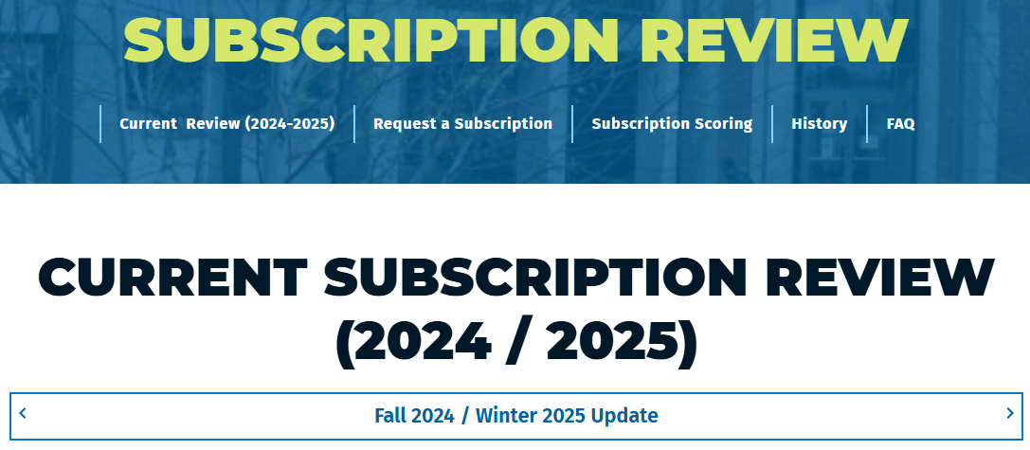
The subscription review process (cont.)
https://library.wwu.edu/subscription-review
Notes:
A central component of our communications strategy for the subscription review is our subscription review webpages, which can be found at the URL shown here (library.wwu.edu/subscription-review)
The site includes updates on the current year review, our subscription request form, a page about how we determine each subscription’s score, information about past subscription reviews, and an FAQ
After today, this is where we’ll be posting the recording of the forum, and we’ll be adding your questions to the FAQ page
If you haven’t explored this site, I encourage you to do so after this afternoon’s forum

Slide 11
Some assurances
ILL & Summit
Books
Services
Notes:
I only have a few more slides, but before I wrap up I want to make a few assurances
First: we remain committed to getting you access to the resources you need, which includes a commitment to both Interlibrary Loan and Summit. If we cancel a journal, we will do everything we can to borrow that content on demand so that you can still do what you need to do
Second: we remain committed to our one-time budget. Subscriptions will not come at the cost of other formats like books and media. We will protect that portion of the collections budget so that we can still acquire these items.
Lastly: we remain committed to our other library services. To the extent that our staffing permits it, we will continue to provide students and faculty with the collaboration and support needed to thrive at Western. Subscriptions will not come at the cost of other pieces of the library mission

Slide 12
Long-term prospects
Notes:
I also want to talk a little bit about long-term strategies to manage the subscriptions landscape
Specifically, as an institution, we should consider organized advocacy around funding for higher ed in general, and academic libraries, in particular
There are several ways we can pool resources and leverage the power of many—including by working with existing consortia like the Orbis Cascade Alliance, of which we are a member, or by partnering with the other public universities in Washington
This kind of collaboration and the cost-savings it can yield statewide might be compelling to legislators in Olympia and might be able to give us a little bit of budgetary relief
If you are frustrated by the ongoing subscriptions crisis, let’s think about advocacy efforts we can take beyond our university

Slide 13
Opportunities for follow-up
Recording, slides, & updated FAQ: https://library.wwu.edu/subscription-review
Subject Teams: https://library.wwu.edu/consult-library-professional#subject
Subscription review survey February 24 – March 21
Notes:
After today’s forum, there are several avenues for follow-up:
First, we’ll post the recording, slides, and an updated FAQ to the subscription review website early next week. You’re welcome to revisit today’s information or share it with colleagues
Second, we encourage you to connect with your Subject Team if you have additional questions, want to talk about your department’s needs and priorities, or want to explore options for advocacy
Connect with us asynchronously or invite us to join you for a department or college meeting—here you can see photos of our Subject Librarians, in case you bump into them in line at Zoe's or remember meeting them at a past event
Lastly, we strongly encourage you to complete the subscription review survey that will open on February 24 and continue through the end of Winter Quarter. The survey is a great way—really, it’s THE way—to tell us specifically which subscriptions are of most value to you, and whether there are new subscriptions you’d like us to add

Slide 14
Q&A (and a few resources)
General subscription review information: https://library.wwu.edu/subscription-review
Subject Teams:
https://library.wwu.edu/consult-library-professional#subject
lib.socialscience@wwu.edu | lib.stem@wwu.edu | lib.humanities@wwu.edu
Libraries’ Collection Services Team:
library.collections@wwu.edu
Notes:
With that, I’ve come to the end of our presentation
Here is some general information that might be of use to you, including the URL for our subscription review webpage, information about how to contact our Subject Teams, and an email for our centralized collections team
I’ll leave this up during the Q&A
At this point, we’ll switch to answering your questions
If you have a question, please pop it into the Q&A – we’ll get through as many as we can this afternoon and then follow up on the rest via our website FAQ
Thank you for joining us this afternoon
Check the subscription review website next week for the recording and updated FAQ
We look forward to hearing from you via our subject teams and the feedback survey starting on the 24th!
Thank you!

